Slide 1

Part two:
MM.DD.YY
Prompting in the real-world

Slide 2
Agenda
Prompting 101
1.
Types of Prompts
2.
Prompts in Play
3.
Let’s Write a Prompt Together
4.
Experiment Results
5.
Drawing a Conclusion

Slide 3


Types of Prompts
Making Observations
Prompting 101
“Create a spectacular image of the evening sunshine”
Prompts range from
“Zero-Shotting”, “
“Multi-Shotting”
“Chain-of-Thought”
“Reasoning Prompt”
“Create me an image of the evening sun. It's glowing ephemeral like. It's wisconsin in the evening and there is birds in the sky. I want you to carefully showcase the many flaws and beauties of nature.”

Slide 4
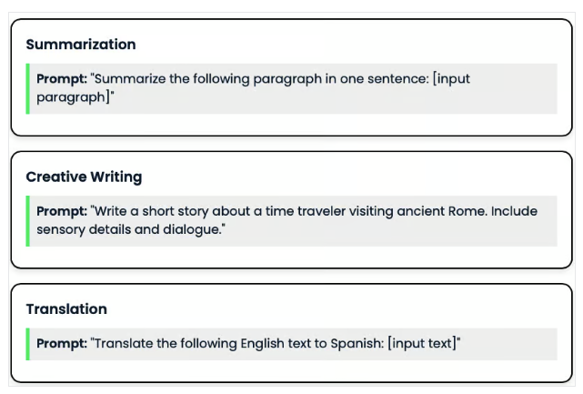
Defining the Problem
Science Presentation
“Zero-Shotting”
A Zero-Shot Prompt is one where you provide no examples for the model. It is a one directional ask and receive.

Slide 5
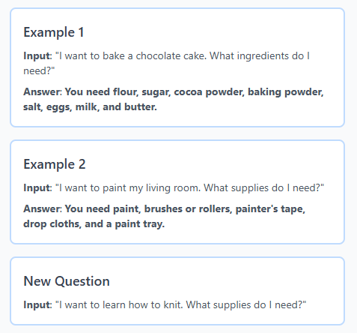
Defining the Problem
Science Presentation
“Few-Shot Prompt”
A few shot prompt is where you provide one or more examples in your prompt. This will help you guide the model in showing you an ideal response.

Slide 6
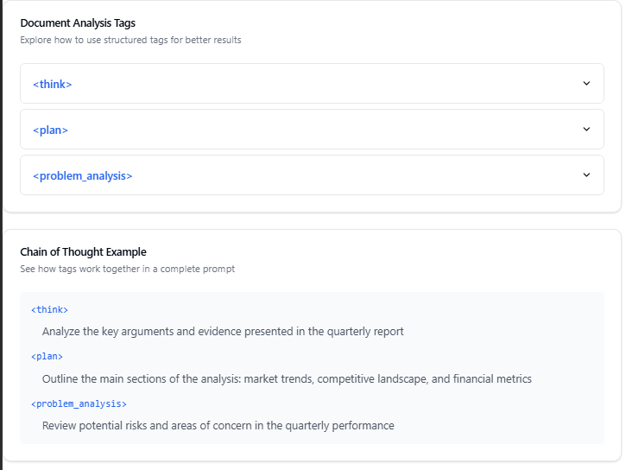
Defining the Problem
Science Presentation
“Chain-of-Thought” Prompt
A Chain-of-Thought prompt explicitly shows your step-by-step reasoning or thought process in the prompt, encouraging the model to emulate that detailed reasoning. Note that, depending on your use case, you may or may not wish to share the full chain-of-thought with the end user. In research and exploration scenarios, it can be helpful.

Slide 7
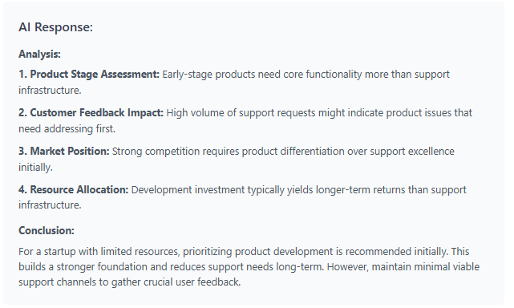
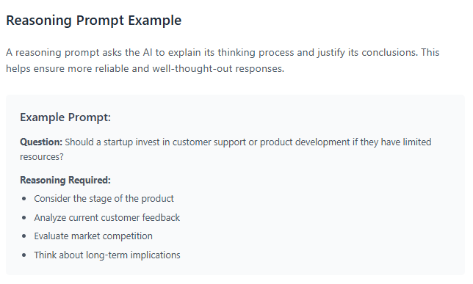
Reasoning Prompts

Slide 8
Agenda
Science Presentation
1.
Types of Prompts
2.
Prompts in Play
3.
Let’s Write a Prompt Together
4.
More Importantly, Images
5.
???

Slide 9
Wanna see it in action?

Slide 10
Zero-Shot Travel
👤
I'm 25 years old, create me a travel plan to go across the world!`
🤖
Around-the-World Plan (Approx. 9–12 Months)
Europe (1–2 Months)
Highlights: London, Paris, Barcelona, Amsterdam (Western Europe) + Prague, Budapest, Krakow (Eastern Europe)
Tips: Use budget airlines/trains and stay in hostels; Eastern Europe is generally cheaper.
Middle East (2–3 Weeks)
Highlights: Istanbul & Cappadocia (Turkey), Petra & Wadi Rum (Jordan)
Tips: Bargain for taxis, sample local street food (shawarma/falafel), use buses for intercity travel.
South Asia (1–1.5 Months),
And so it went on in the same format…

Slide 11
Multi-Shot Prompting
Shoes: You are a trip advisor.
Context - I am a 25 year old male looking to travel the world. I have never been outside of
North or South American and I'd love to travel the rest of the continents.
Outcome- I would love to be able to do it within 4 months. I am hoping to travel to as
many places as possible according to flight cost averages. I have a budget of around
$5,000 usd.
Scale - The goal is to make it to as many unique and timeless places as possible, with an
emphasis on history.
Time- In less than 4 months, preferably.
Actor- the individual with the support of locals and his phone for guidance. I will use AI to
help me translate.
Resources - Access to a translator (phone), hotels need to be nearby but also hostels are
okay. I like to backpack in safe places.

Slide 12
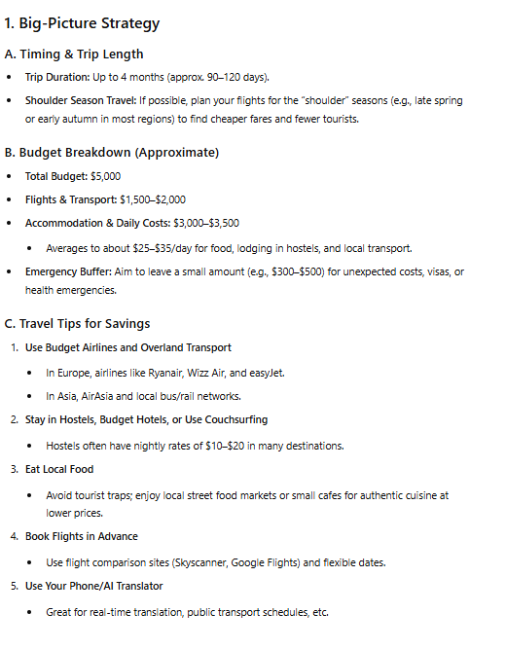
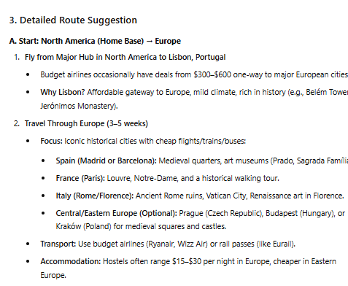
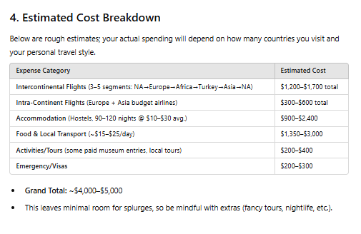
It’s response…
What to expect

Slide 13
What did we do here?
First:
Third:
We Identified it’s “Shoes” AKA its role to play
Next, we did the S - Style, this ensures you get the kind of voice you want, depending on what industry you’re in. Following that, we have T- Tone, requires the AI to craft a response that resonates.
Second:
Lastly,
We added it’s C - Context, the reason behind the what. Then, we added the O - the Objective, for the task.
The most important ones: A - Audience, this tailors it’s response/rhetoric for the intended user, and finally, R - Response, requires the AI to responde in a text, numerical, or a formatted schema type of way.

Slide 14
Agenda
Science Presentation
1.
Defining the Problem
2.
Making Observations
3.
Let’s Write a Prompt Together
4.
More Importantly, Images
5.
???

Slide 15
Marketing Example Prompt
You are a professional Creative. Context: I am writing a friendly marketing email campaign for my business that is involved with selling textiles (ie., carpets, rugs, and flooring.) Our target audience for this campaign will be for residents in the area that have bought goods from us in the last five years. Objective: Our goal is to come back and buy new rugs, sell more merchandise, and get on our new steam-cleaning program. I want you to write compelling copy with prompts for engaging photos Style: I want you to write with minor sass, keep it simple but engaging! Lightheartedness goes a loooong way in our neighborhood. Tone: I want you to ensure that residents within the Midwest would find the ad compelling. Audience: Homeowners between the ages of 25-68. Family Friendly - Upper-middle class types of homes. Response: Text detailing inverals of email sendouts. Headlines, Copy materiel, along with ideas for images from generation to self-inserted.

Slide 16
Now you create your prompt for Marketing, Scheduling, or even Vendor Vetting/Analysis…

Slide 17
Agenda
Science Presentation
1.
Defining the Problem
2.
Making Observations
3.
Forming a Hypothesis
4.
More Importantly, Images
5.
Concluding Thoughts

Slide 18
Images..
Let’s play a little game.
Is it AI Generated?

Slide 19
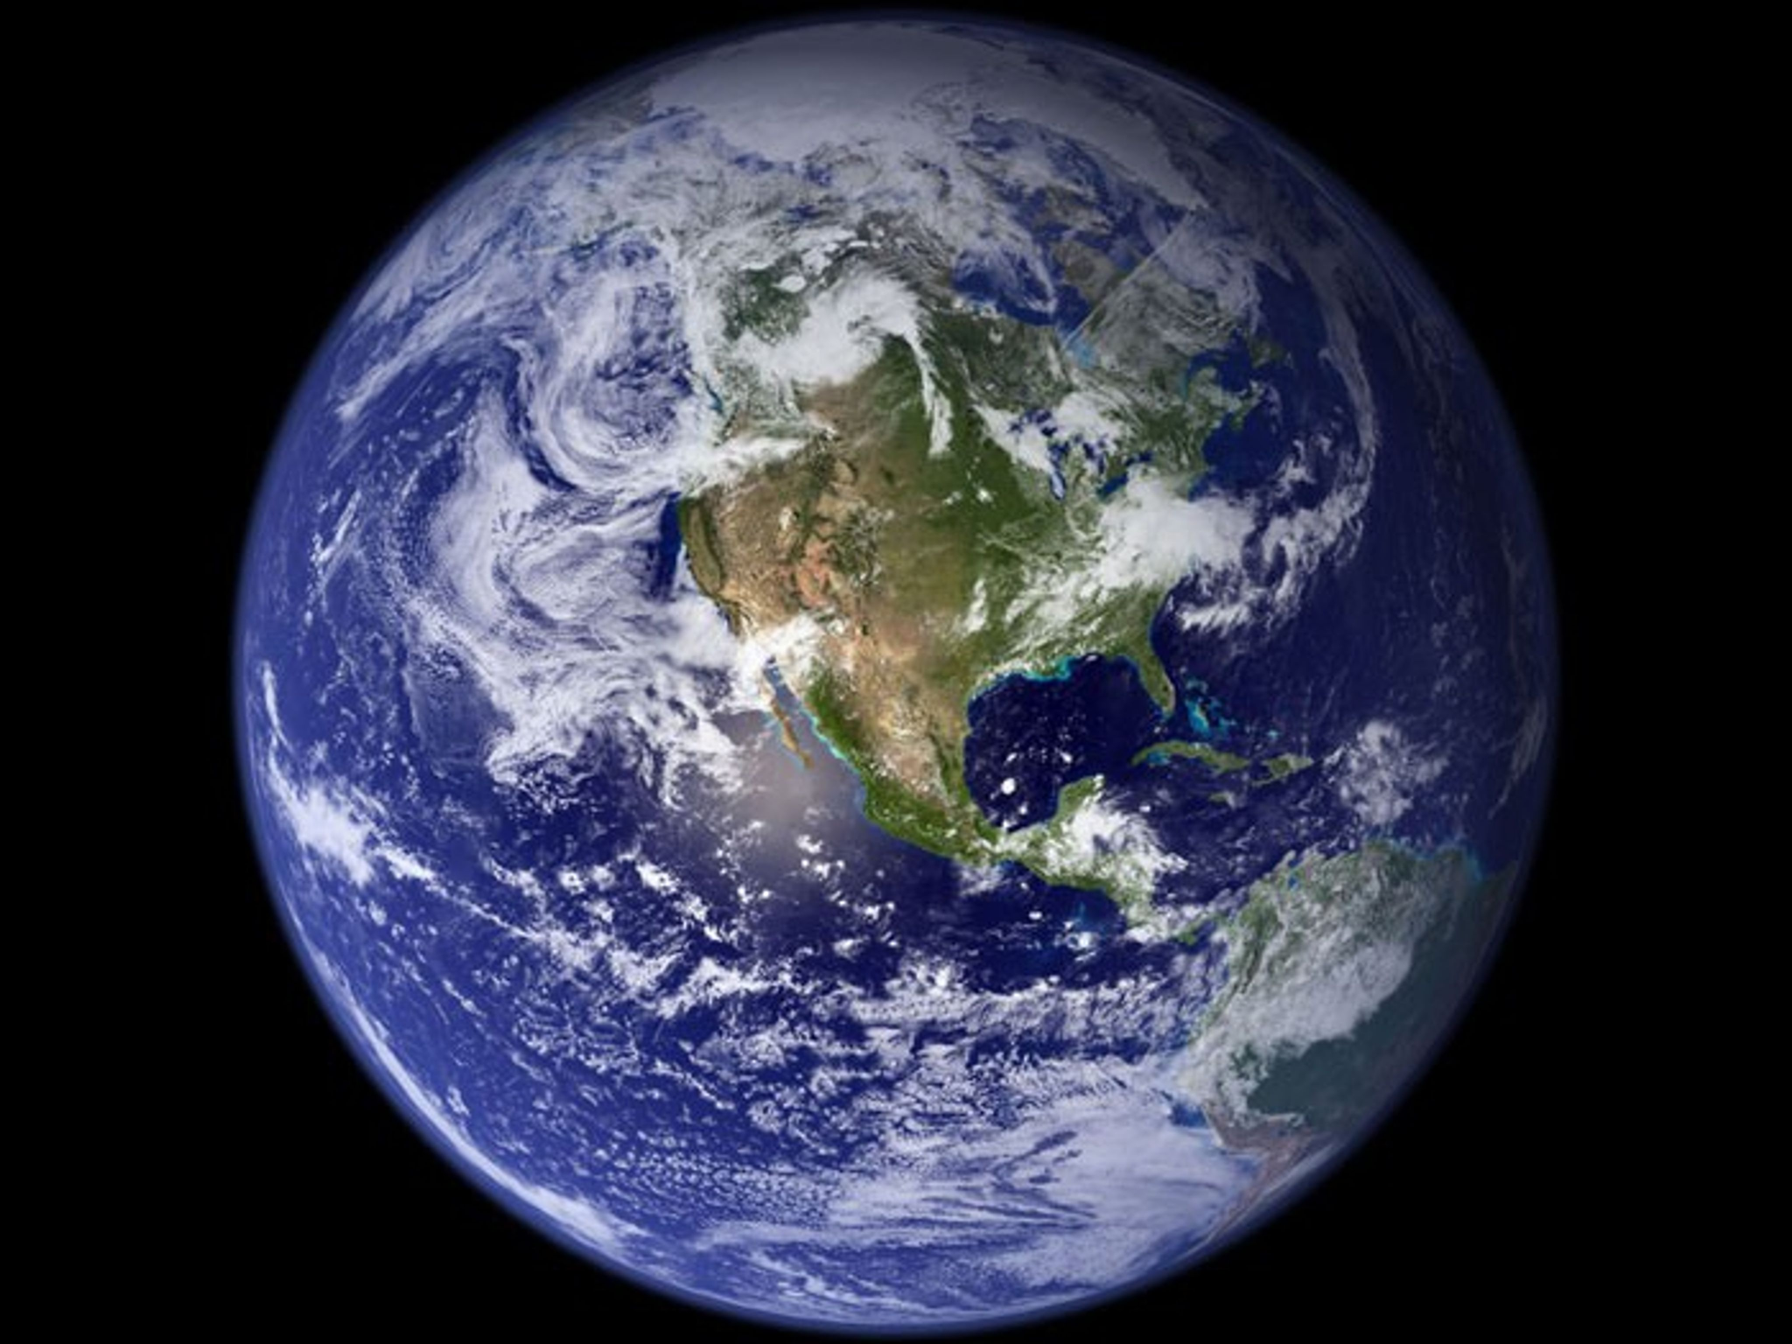
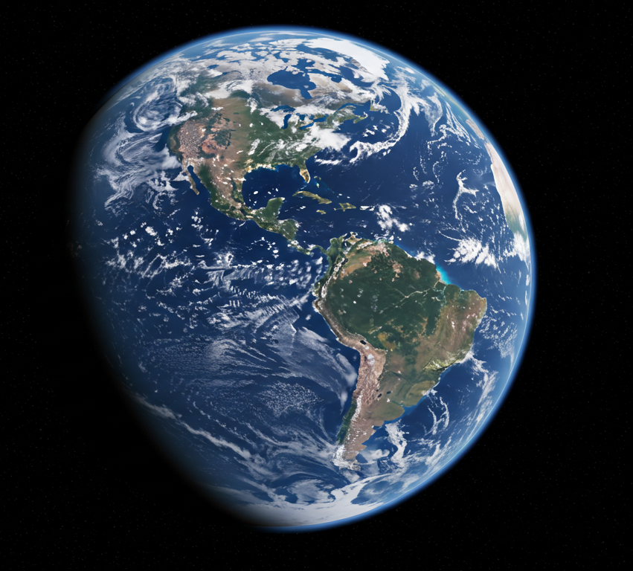
Which one is the real blue marble photo

Slide 20
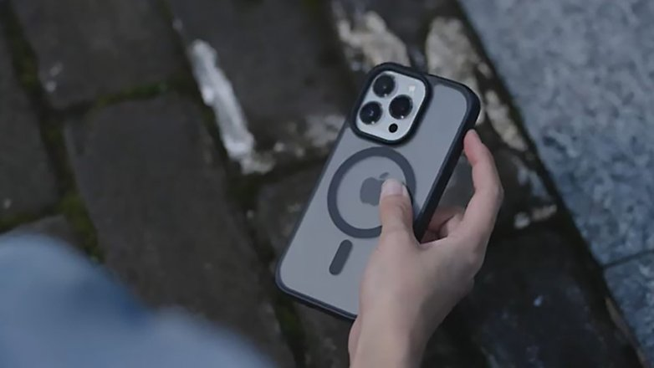


Slide 21



Slide 22


Slide 23
How do you create AI images..?
Free Tools:
Imagefx by Google: Free along with a Google Account
Microsoft Designer by Microsoft: Free Along with your Microsoft 360
Canva by Canva: A generous amount of credits per each user! Free of charge.
Paid Tools?
Sora by OpenAI; Known for CHAT GPT, you can create videos and screenshot frames from the video (hyper-realistic)
Mid Journey by Mid Journey: Known for its early breakthroughs in Image Generation, it offers unique capabilities
Plenty of others out there, just be careful of what you buy in the startup world.

Slide 24
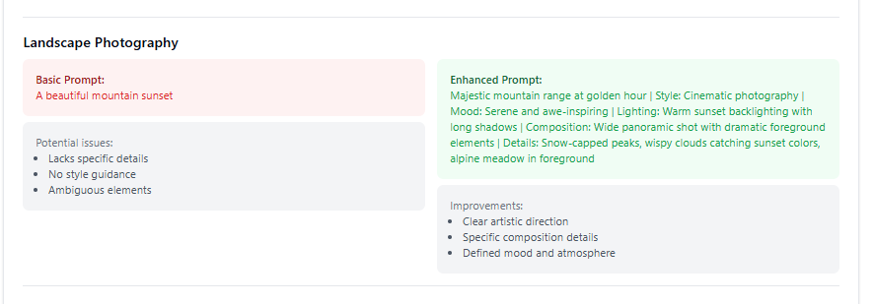
How do you prompt it?

Slide 25
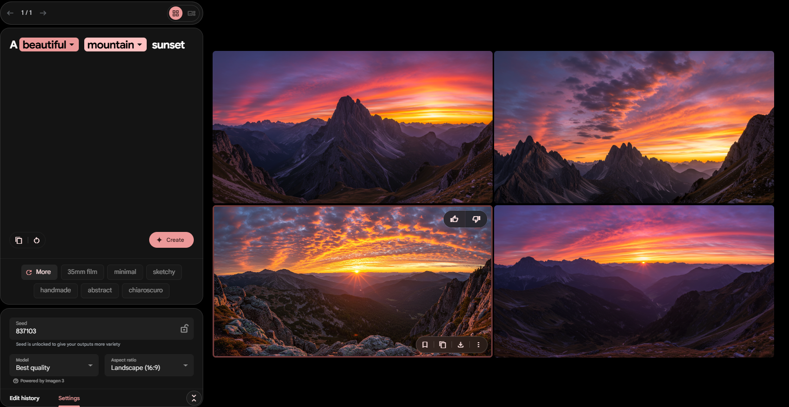

Slide 26
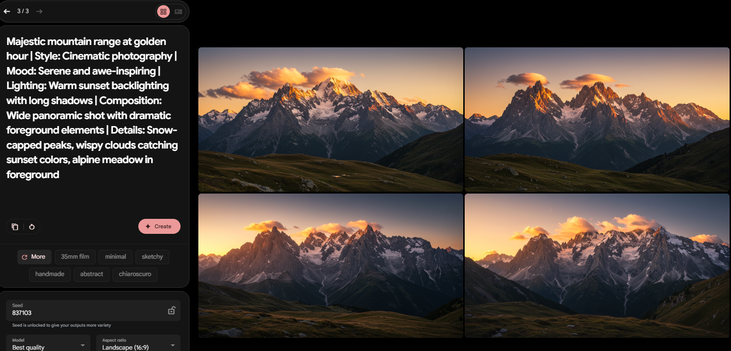

Slide 27
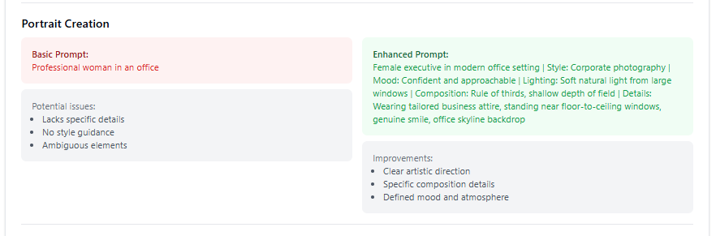
How do you prompt it? Pt 2

Slide 28


Slide 29
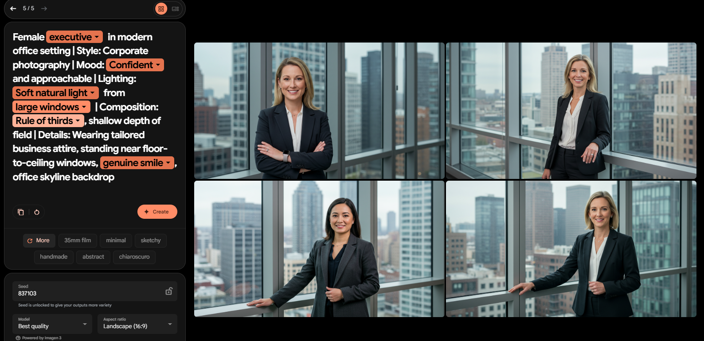

Slide 30
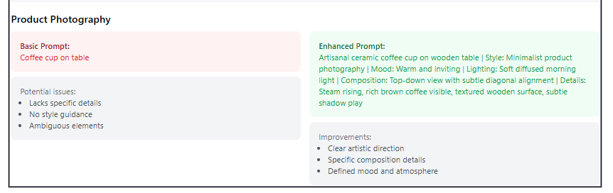
How do you prompt it? Pt 3

Slide 31
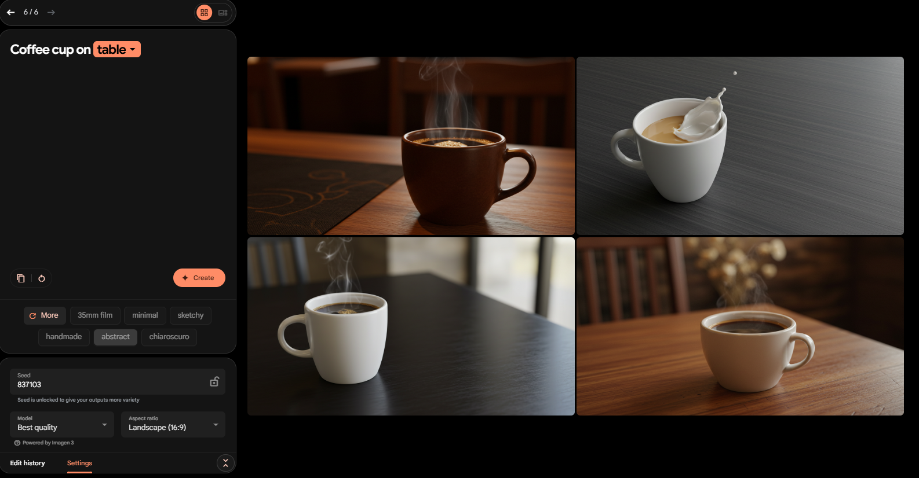

Slide 32
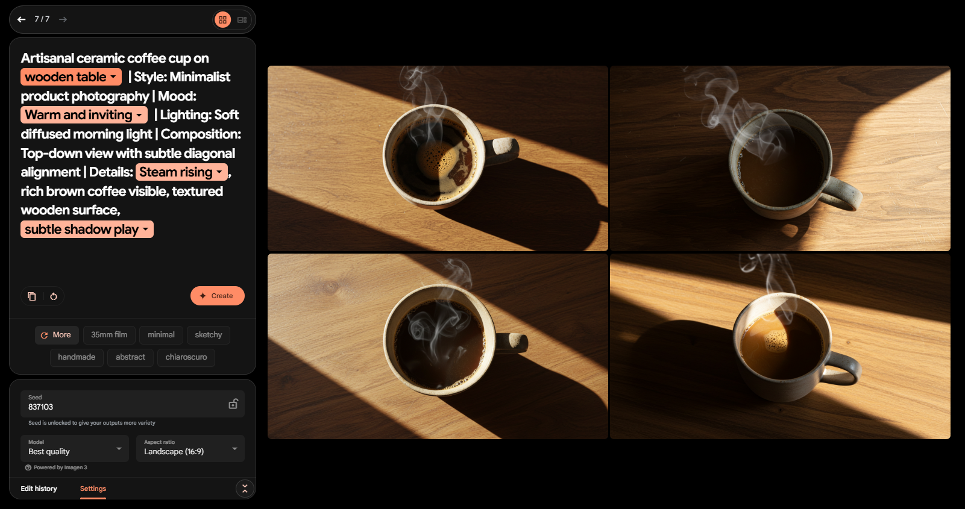

Slide 33
Agenda
Science Presentation
1.
Types of Prompts
2.
Prompts In Play
3.
Let’s Write A Prompt Together
4.
More Importantly, Images
5.
Concluding Thoughts

Slide 34
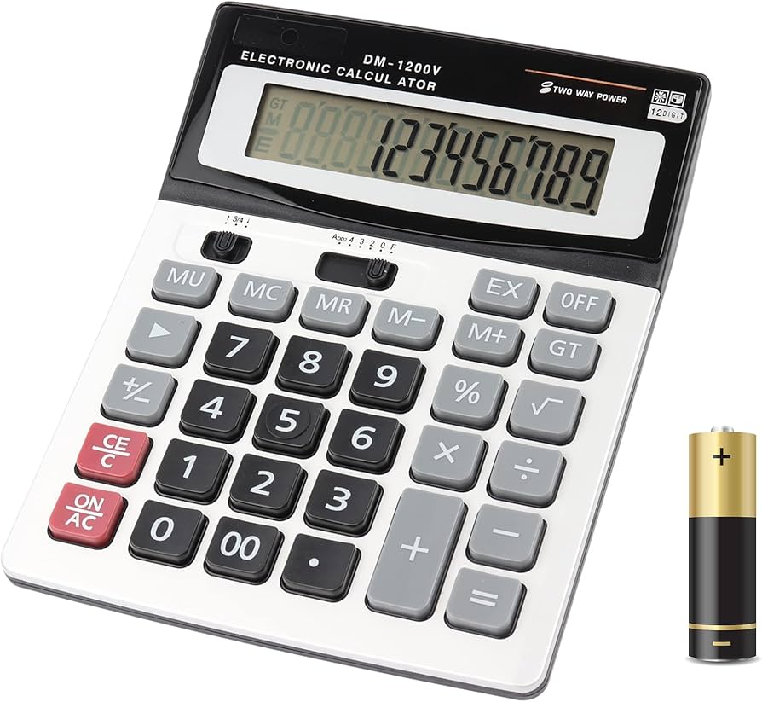
Just how this was a tool for math
Prompting is a tool for AI.

Slide 35
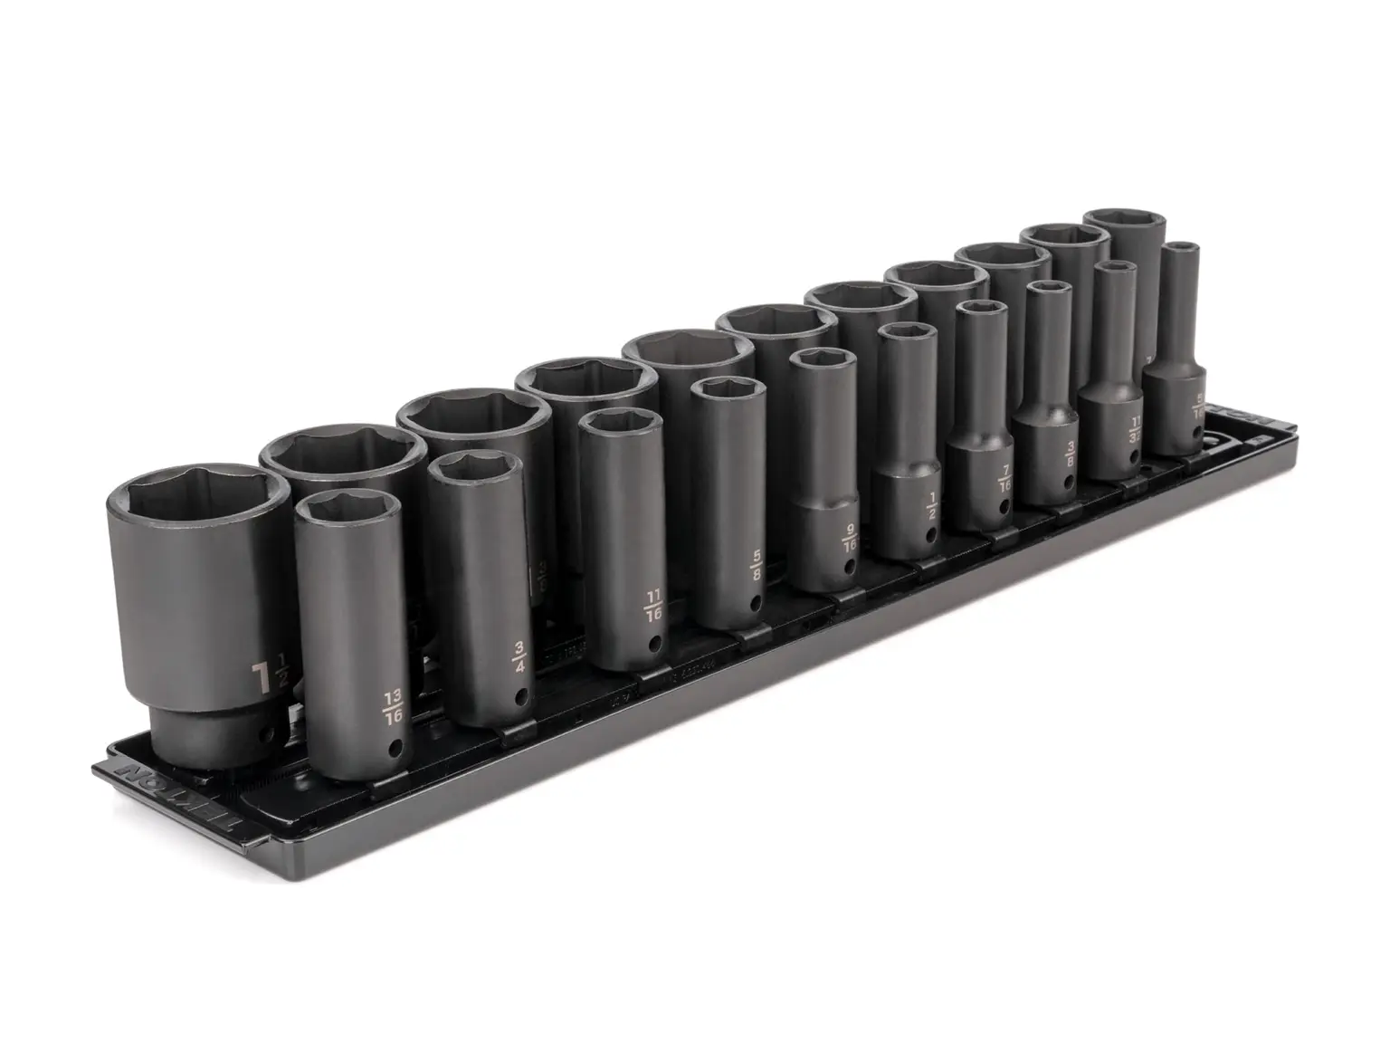
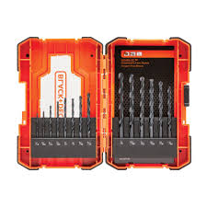
And this:
Or that!

